Slide 1
PROJECT AIM ON ANALYSING AND VISUALIZING NREGA DATA USING POWERBI
Presented by,
C. Meghana,
Batch No: MIP-DA-09

Slide 2
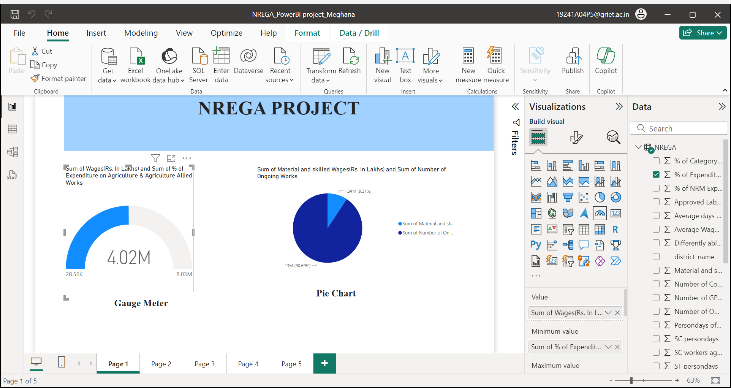

Slide 3
PROBLEM STATEMENT
How effective is NREGA in providing employment opportunities to rural households?
Are there regional disparities in the implementation and outcomes of the scheme?
What is the utilization of the allocated budget, and how does it correlate with employment generation?

Slide 4
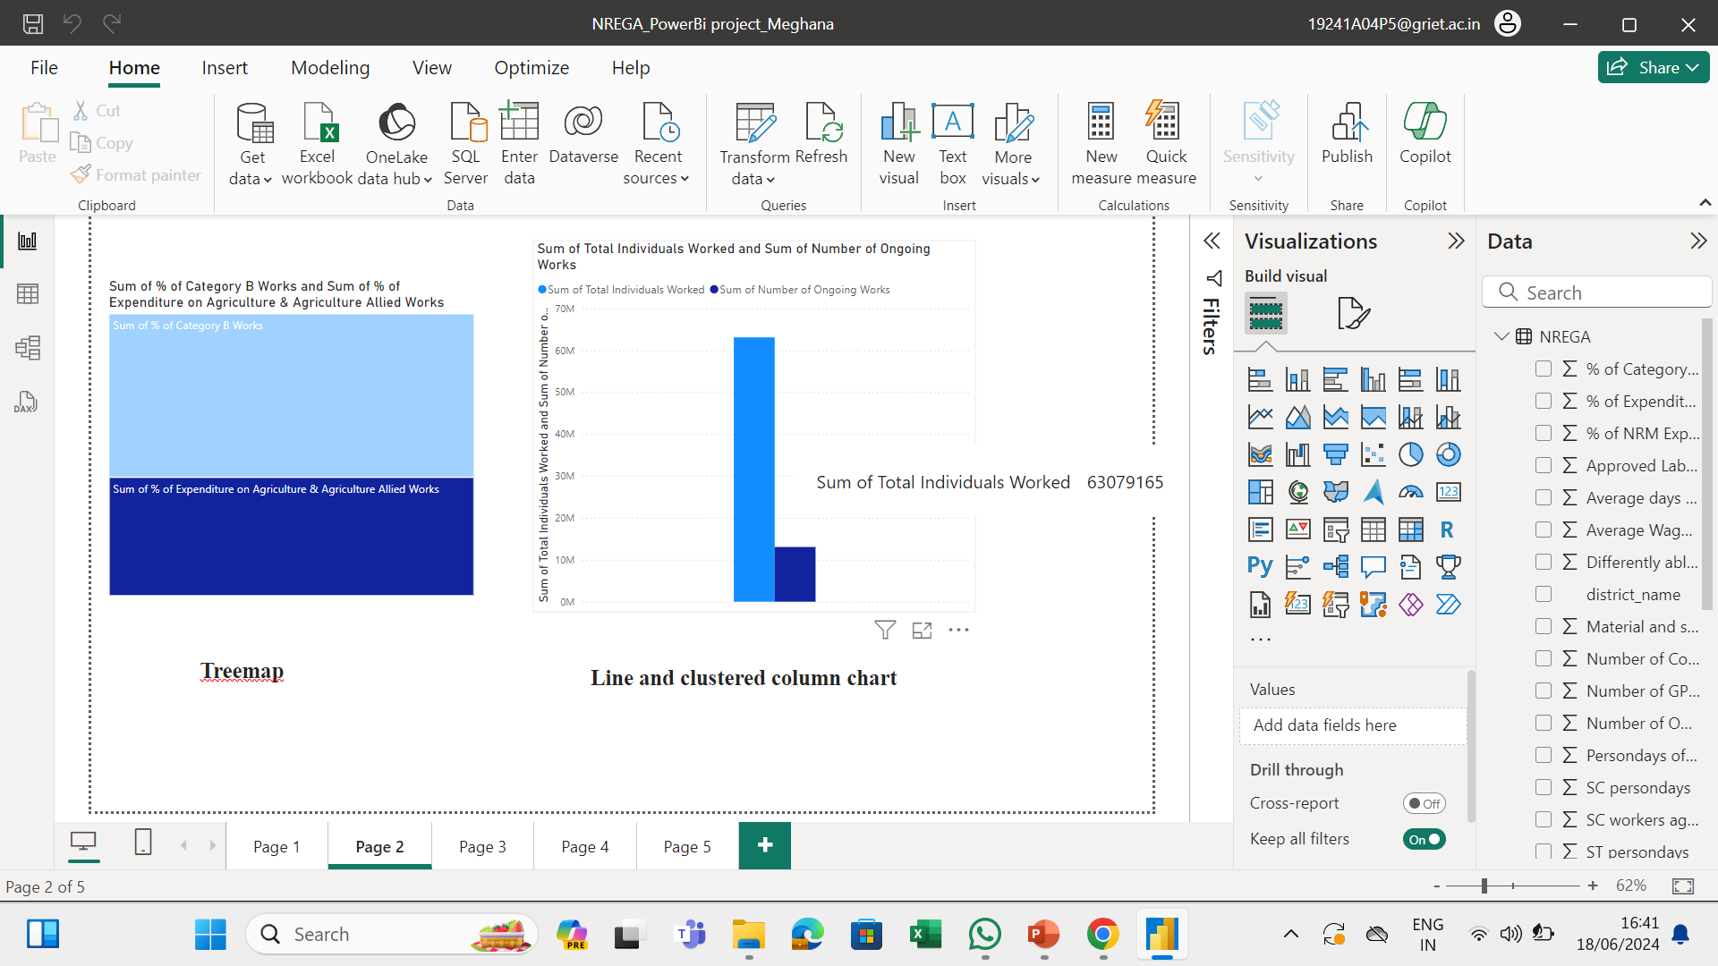

Slide 5
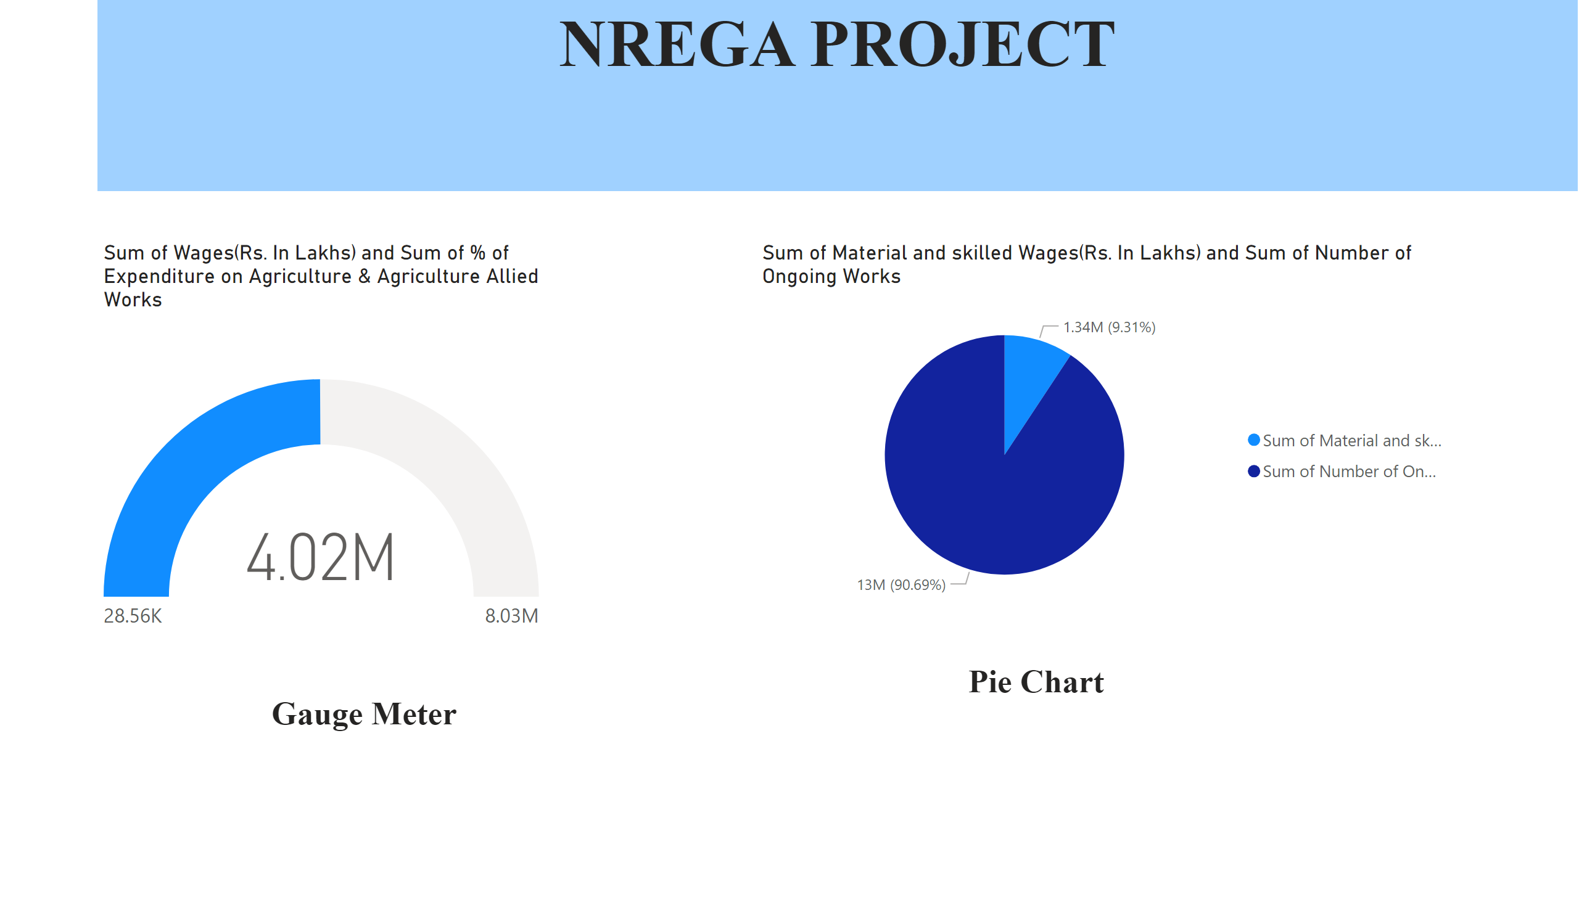
Page 1
Notes:
gauge
No alt text provided
textbox
No alt text provided
pieChart
No alt text provided
textbox
No alt text provided
textbox
No alt text provided
textbox
No alt text provided

Slide 6
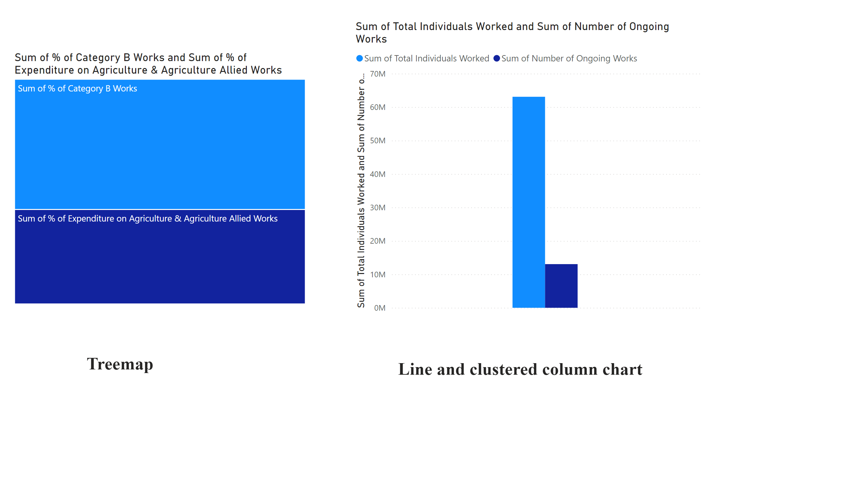
Page 2
Notes:
treemap
No alt text provided
lineClusteredColumnComboChart
No alt text provided
textbox
No alt text provided
textbox
No alt text provided

Slide 7
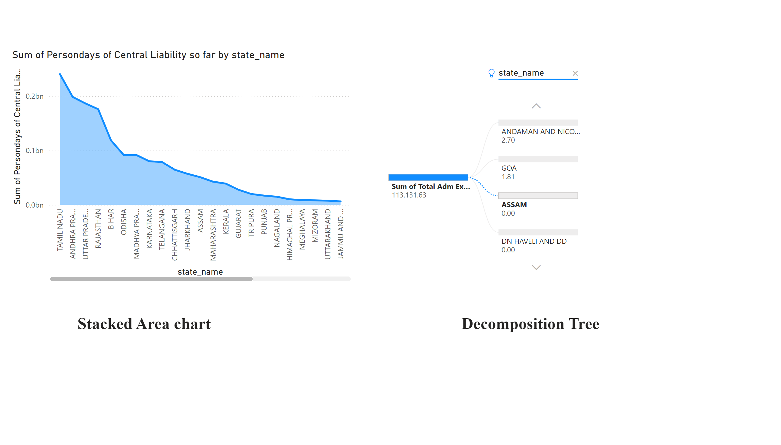
Page 3
Notes:
stackedAreaChart
No alt text provided
decompositionTreeVisual
No alt text provided
textbox
No alt text provided
textbox
No alt text provided

Slide 8
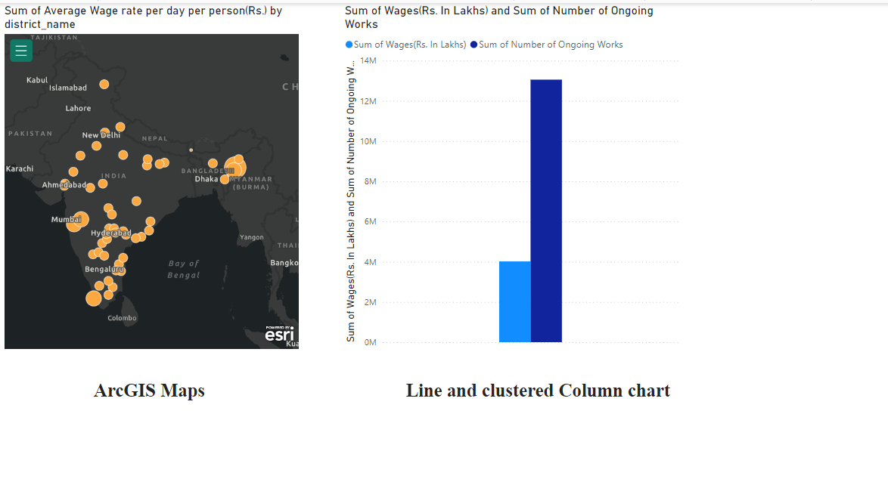
Page 4
Notes:
esriVisual
No alt text provided
lineClusteredColumnComboChart
No alt text provided
textbox
No alt text provided
textbox
No alt text provided

Slide 9
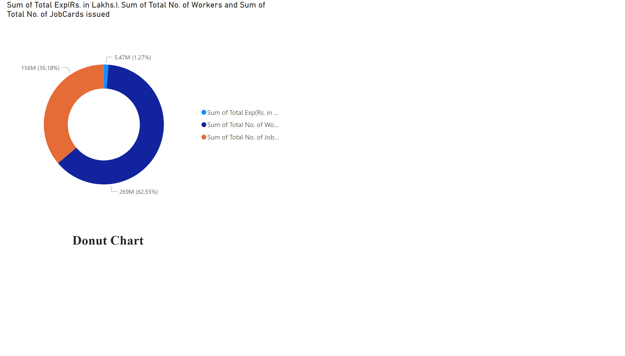
Page 5
Notes:
donutChart
No alt text provided
textbox
No alt text provided

Slide 10
CONTINUED…
What are the key factors contributing to the completion of NREGA works, and are there any roadblocks to its success?

Slide 11
KEY FACTORS AND ROADBLOCKS OF NREGA WORKS
Key Factors:
Adequate Funding
Effective Planning and Implementation
Use of Technology
Roadblocks:
Delay in Wage Payments
Seasonal Constraints
Lack of Awareness

Slide 12
CONTINUED…
Can data-driven insights guide policymakers and administrators in optimizing the scheme's impact?

Slide 13
DATA-DRIVEN INSIGHTS
Identifying Gaps and Inefficiencies
Improving Resource Allocation
Enhancing Transparency and Accountability
Facilitating Better Planning and Execution

Slide 14
THANK YOU!

